Slide 1
Safety briefing JWGC 2022

Slide 2
On the ground
Taking off
Waiting for the line
On track
Finishing

Slide 3
On the ground/in the grid
Be prepaired, be ready
Sit in the glider well before take off
Crew present

Slide 4
Taking off
When picking upp slack -> brake
Flapped gliders -> start negative
Unflapped gliders -> use airbrakes
Leave gear down until at safe alt
Stay on tow until waved off

Slide 5
Waiting for the line
(Most) dangerous part of the flight…. : -Busy with all kind of things -Very high concentration of gliders
-Big speed difference between club/std in thermals

Slide 6
On track
Common rules:
Join from the outside
Don’t turn inside other gliders
Don’t turn to shallow
Turn in the same direction!
Adapt your speed to others in thermal
When leaving, level off in direction you want to go to

Slide 7
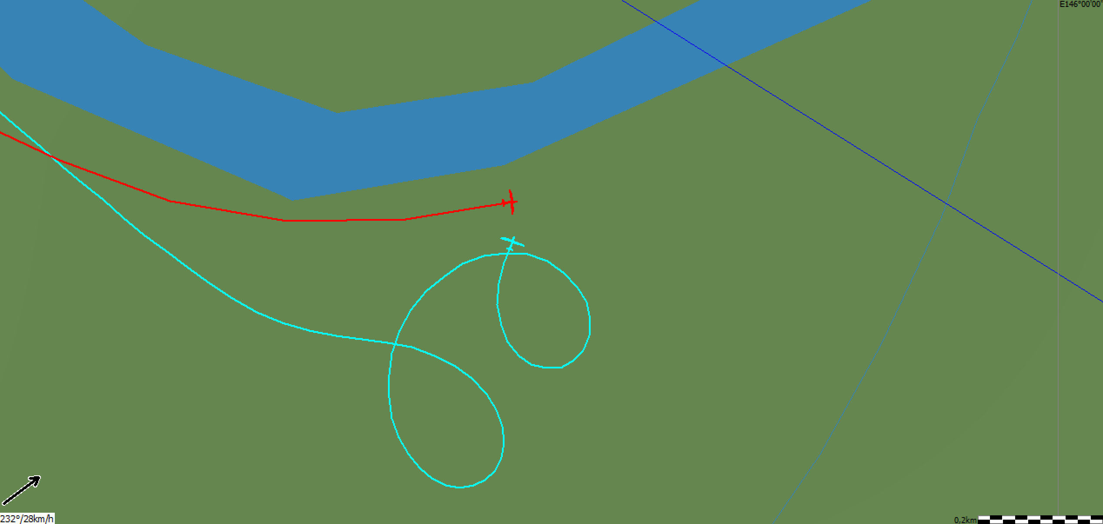
Joining Thermals

Slide 8
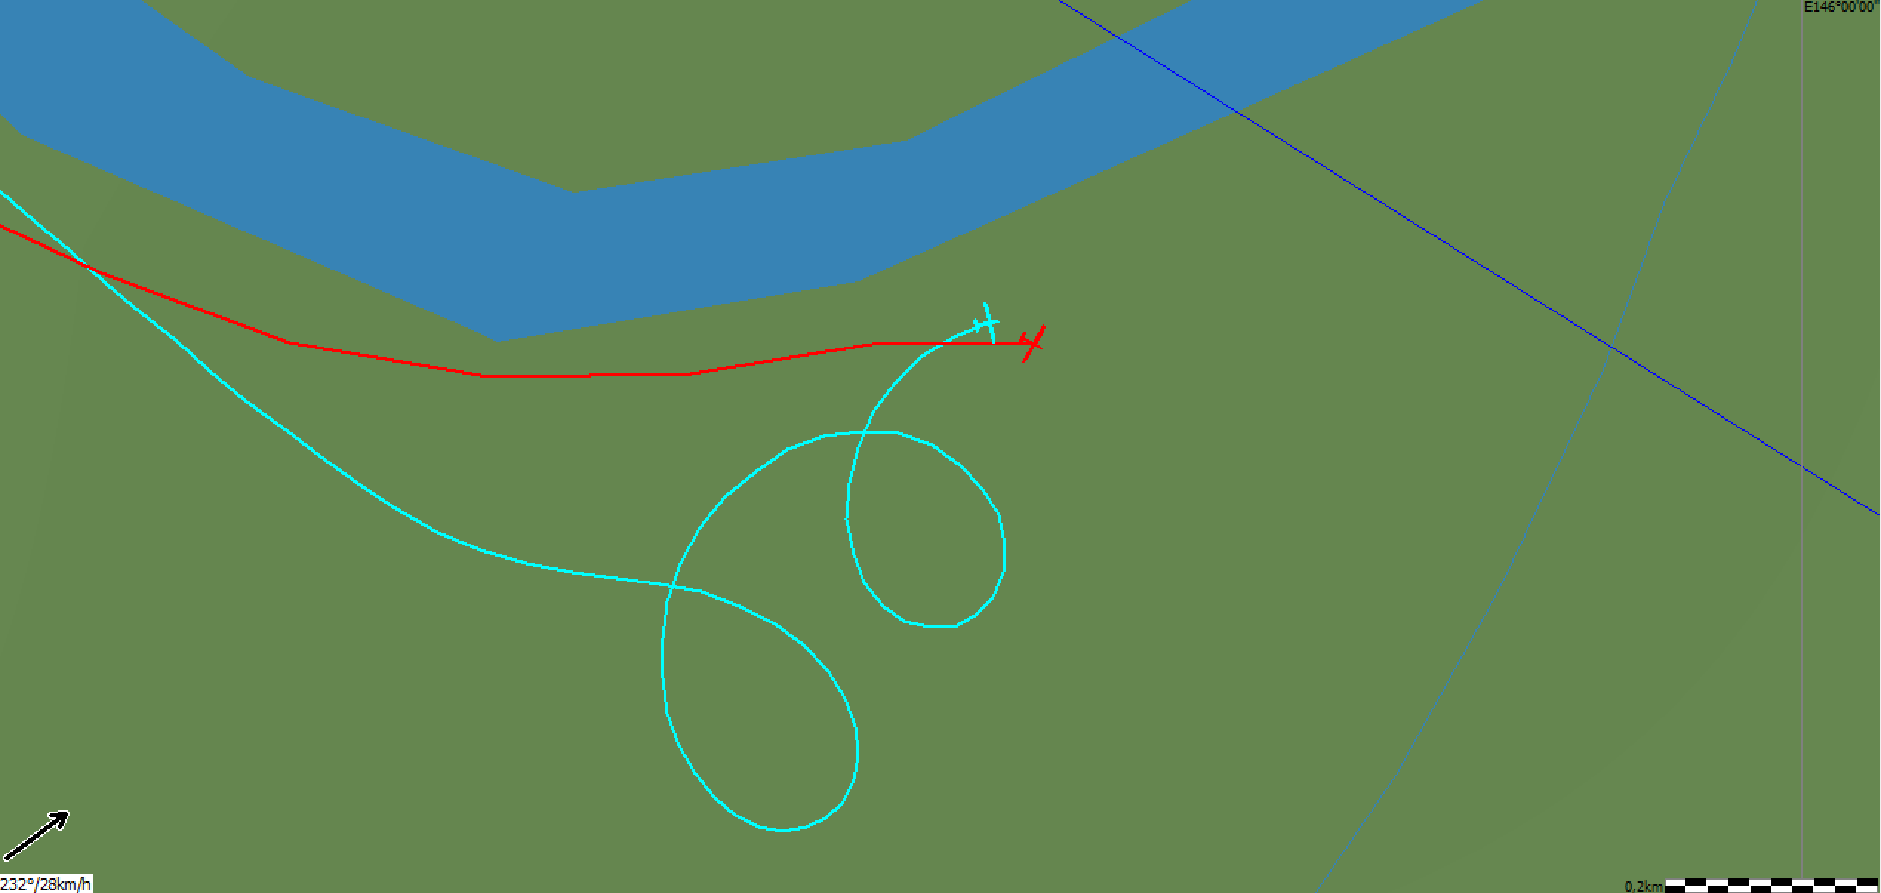

Slide 9
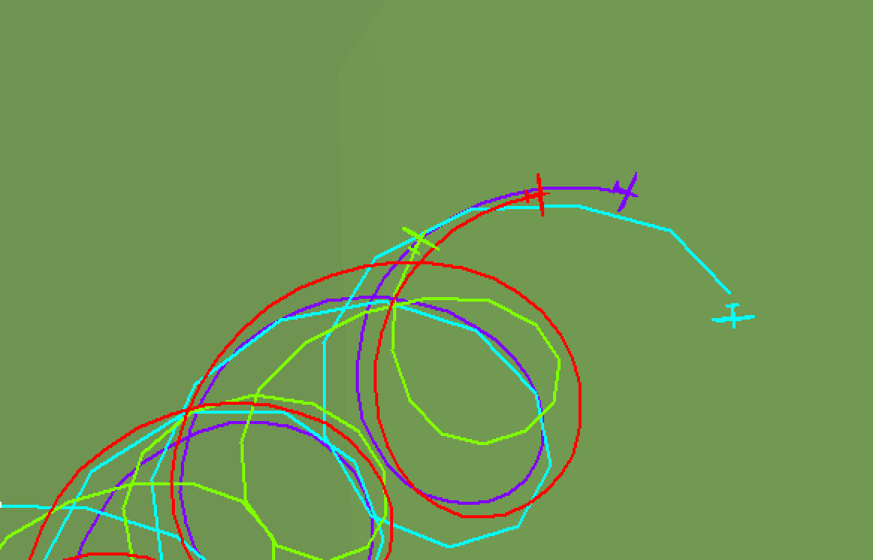
Inside Thermals

Slide 10
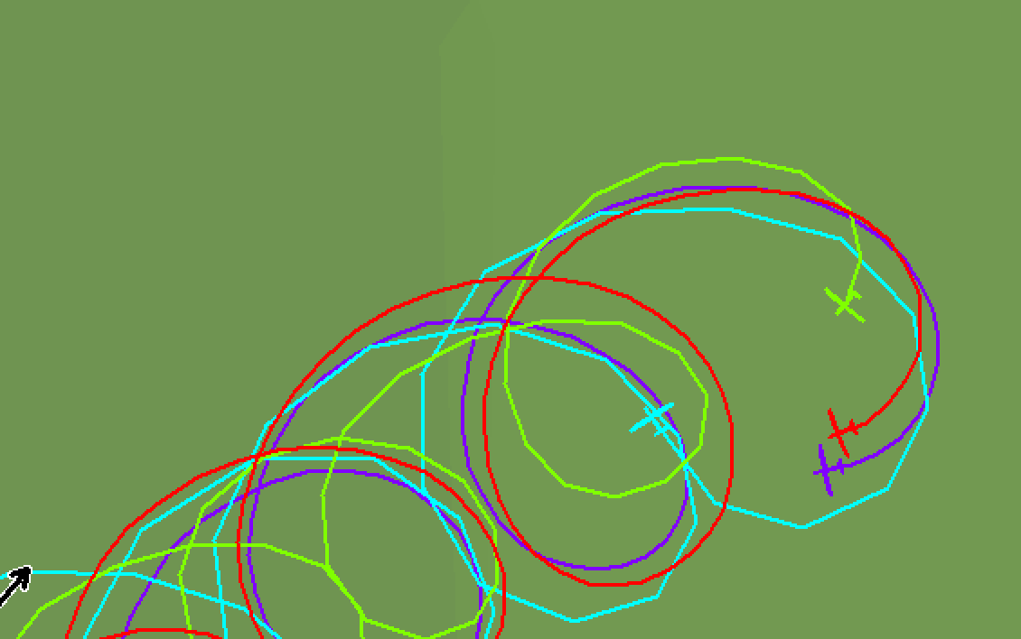

Slide 11
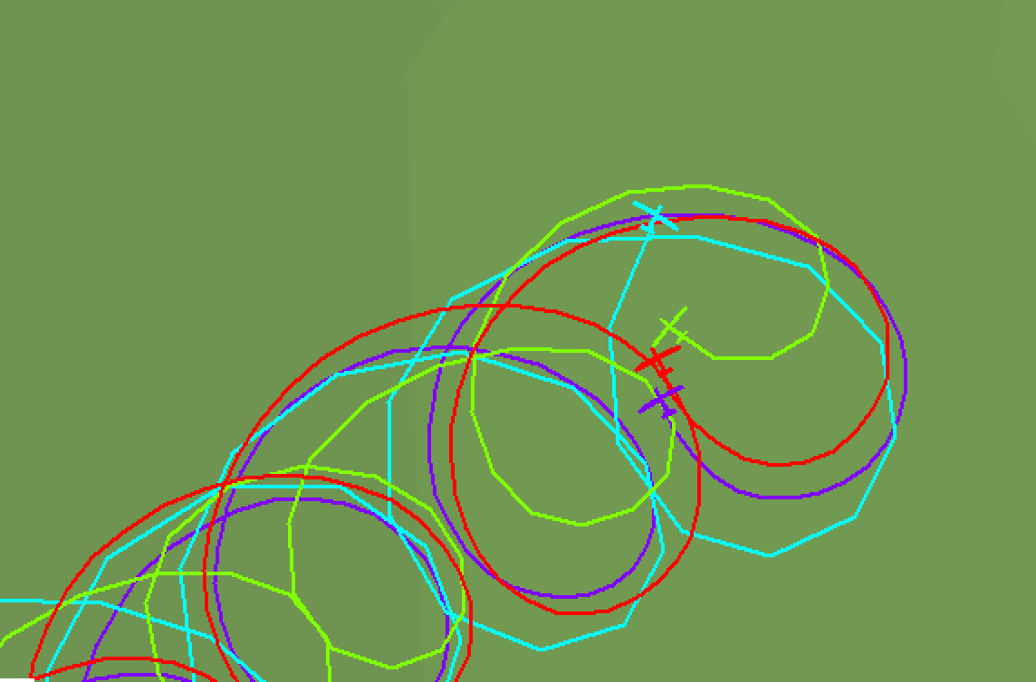

Slide 12
Flying through a thermal

Slide 14
Midair incident WGC 2017 Benalla

Slide 15
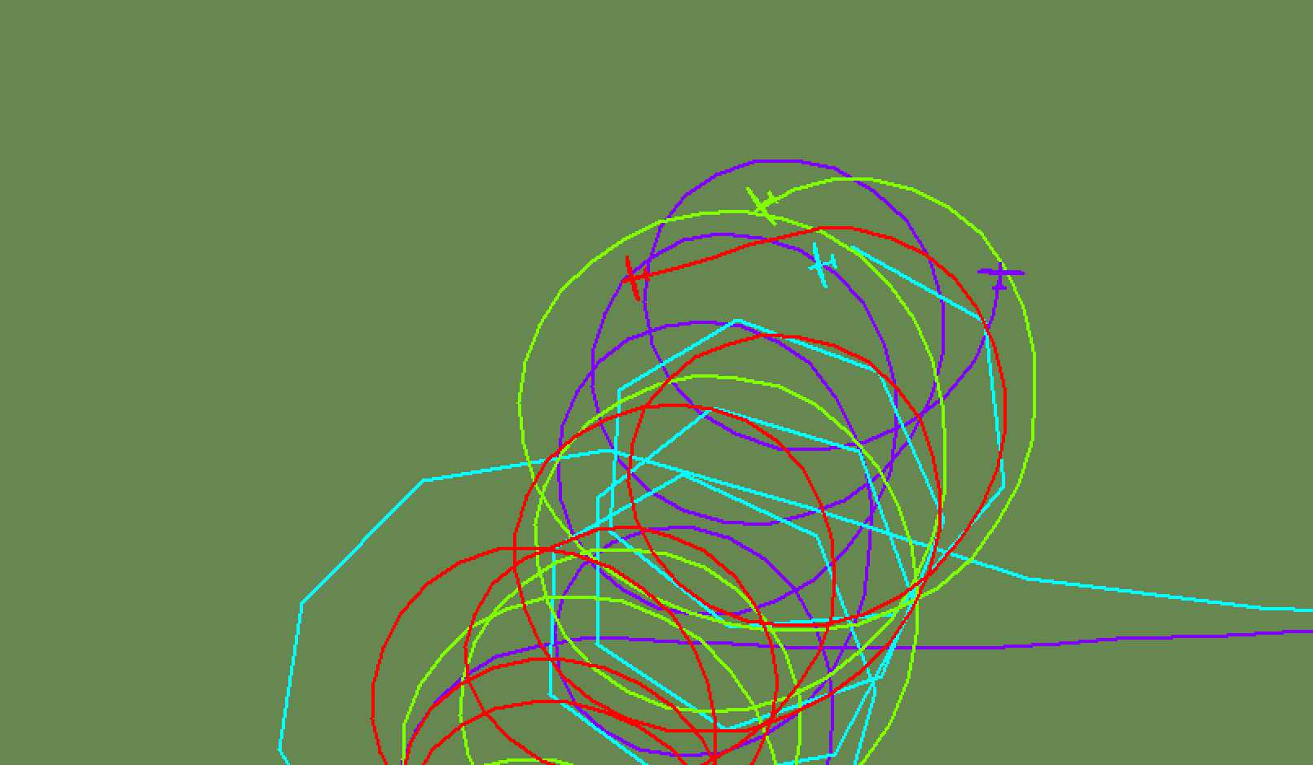

Slide 16
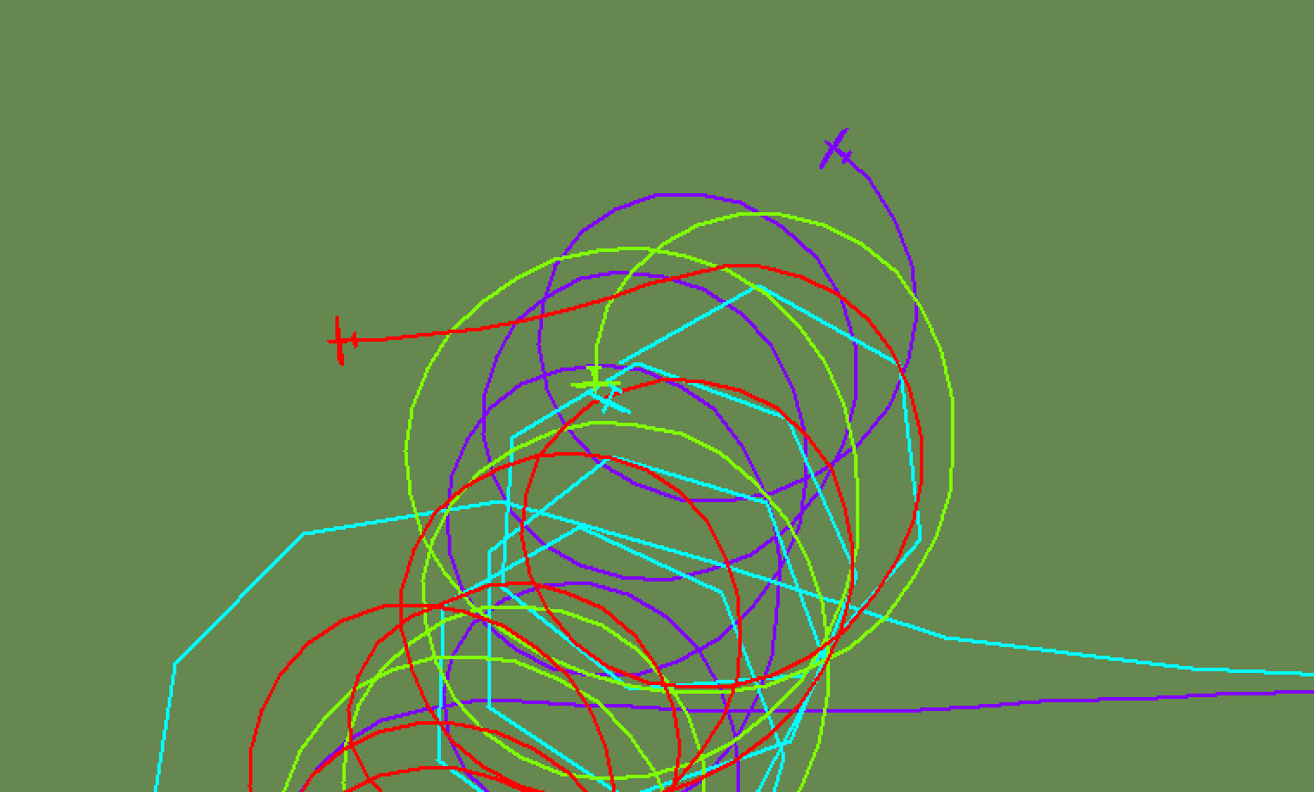

Slide 17
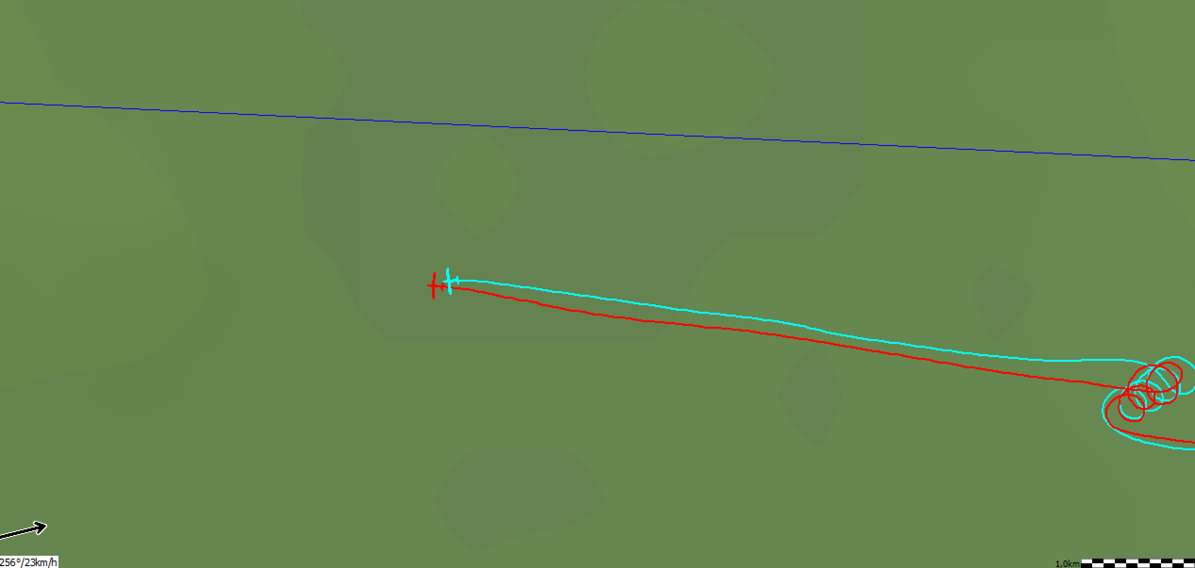
Cruising

Slide 20
Recommendations
Enter thermals from outside not from middle
Fly the same circles as the others or find your own thermal (not circling inside, but also not at the outside..)
When leaving the thermal, Leave It!
Scan complete field of vision in straight flight and in thermals
Do not switch off your flarm
Wave to the other pilots!!

Slide 21
Finishing
-Do 10 km call for other gliders’ awareness
-Don’t pull up steeply after passing the line
-Let energy bleed away until 100-130 km/h
-When with many gliders; communicate!
-Minimum finish alt is a minimum…
-When in doubt? Minimum risk option
*go back and land out
*fly over terrain where outlanding is possible
*or avoid by finishing higher ☺

Slide 22
Safety in general
Talk to the other pilot after landing
Safety pilots/steward
Safety Box
Complaints
Rules → Dangerous Flying → Penalty
Feelings of Safety are subjective!
(Not always right or wrong)
Comfortzones are different

Slide 23
Safety pilots/steward
Steward/chairman: Enrique Lippe
Club class : Jelmer Vis (VIS)
Standard class : Kevin Faur (21)

Slide 24
Thanks for your attention
Questions?

